Slide 1
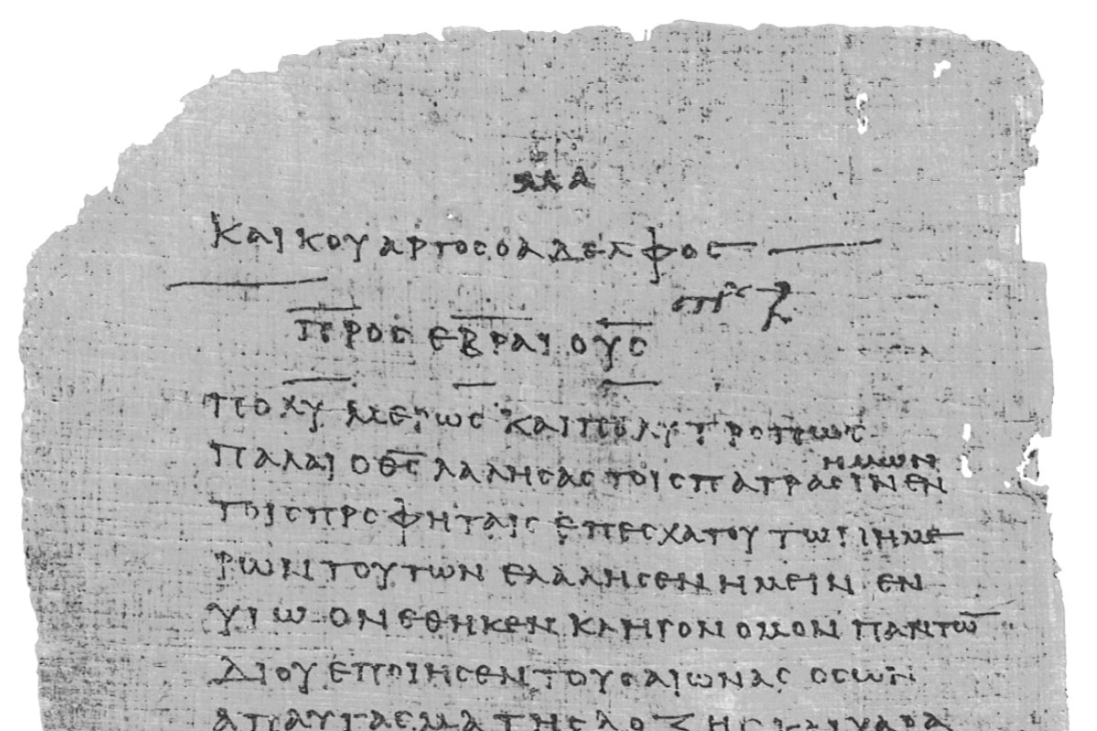
Pharisee Paul’s ἀπολογία to the Hebrews
Ἑβραῖος
Session-16
Hebrews 8:7 thru 9:18
The NEW Covenant
Dr. Dave Newton
© 2025
Figure It Out
Calvary Chapel
Santa Barbara

Slide 2
Pharisee Paul’s ἀπολογία to the Hebrews Ἑβραῖος
Last Week ended with . . .
Hebrews 8:6 Jesus has obtained a more excellent ministry
He is Mediator of Better Covenant enacted on Better Promises
Paul Quotes
Jeremiah 31:31 NEW Covenant with Israel and house of Judah
v-32 NOT like covenant I made with their fathers as I led them from Egypt
a covenant that THEY broke although I was a husband to them
v-33 but now I will put my Law within them – written on their hearts
I will be their God and they will be my people
v-34 they will not have to teach this because they will ALL KNOW ME!
2nd Corinth. 3 NEW Covenant not of the letter but of THE SPIRIT
Galatians 3 NEW Covenant does not invalidate the original Promise

Slide 3
Pharisee Paul’s ἀπολογία to the Hebrews Ἑβραῖος
Tonight FLOWS . . .
Old and New Covenant Earthly Tabernacle and Heavenly Temple
Hebrews 8:7-10
For if that first covenant had been faultless, there would have been NO occasion
sought for a second - for finding fault with them, He says, “Behold days are coming when
I will effect a NEW covenant with the house of Israel and house of Judah, not like the
Covenant which I made with their fathers on the day I tool them by the hand to lead
them out of the land of Egypt, but they did not continue in My covenant and I do not
care for them, says the Lord, for this is the covenant that I will make with the house of
Israel after those days, says the Lord . . . I will put my laws into their minds and will write
write them on their hearts, I will be their God and they shall be my people
Law is SPIRITUAL Mankind is CARNAL Romans 7:14
Law was WEAK thru mankind’s FLESH Romans 8:3

Slide 4
Pharisee Paul’s ἀπολογία to the Hebrews Ἑβραῖος
IF that first covenant had been faultless NO need for a second covenant
NOT fault of 1st Covenant but fault of the People!
Romans 7:14 we know Law is spiritual, I am of flesh sold into bondage [slavery] to sin
YHWH finds fault with Israel: Days are coming when YHWH will do NEW covenant
with Israel [NATION] and Judah [TRIBE]
NOT like with their Hebrew fathers out of Egypt - SINAI
They did not continue in that Covenant [FAULT] the result “I do not care for them”
This NEW Covenant = I will put my laws into their minds
I will write my laws on their Hearts Deut. 6:5 Soul Mind Strength
I will be their God and they shall be my people
OLD Covenant written by God’s fingers on tablets of stone
NEW Covenant written by Holy Spirit on human heart + mind Jeremiah 31:31
2nd Corinth. 3

Slide 5
Pharisee Paul’s ἀπολογία to the Hebrews Ἑβραῖος
Hebrews 8:11-13 and they shall not teach everyone, his fellow citizen,
and everyone his brother saying, “Know the Lord”
for ALL will know Me, from the least to the greatest of them
for I will be merciful to their iniquities
and I will remember their sin no more! in the Millenium Kingdom!
When He said, “A New Covenant,” He has made the first obsolete.
But whatever is becoming obsolete and growing OLD is ready to disappear
“OLD” is γηράσκω gerasko παλαιός palaios ἀρχαῖος archaios
growing old failing due to age worn out by use around since beginning
Verb Paleontology no more use Archaeology - Car still driven
Obsolete and remains that
[perfect tense]

Slide 6
Pharisee Paul’s ἀπολογία to the Hebrews Ἑβραῖος
Hebrew people will not have to teach “Know God’s Law” because
EVERYONE [fellow citizen, brother, family] Will Know ME
from least to greatest
YHWH will be merciful to their iniquities and remember their sin no more!
When YHWH said, “NEW covenant” That made 1st one obsolete
Whatever is becoming obsolete - growing old is ready to disappear
Blood of goats and lambs and bulls could NEVER take away sin,
BUT John 1:29 behold the Lamb of God who takes away the sins of the world

Slide 7
Pharisee Paul’s ἀπολογία to the Hebrews Ἑβραῖος
Arguably 8 Covenants in the Hebrew Scriptures
- Eden Genesis 2:16 Time of Innocence
- Adam Genesis 3:15 Time of Conscience
- Noah Genesis 9:16 Time of Human Government
- Abram Genesis 12:2-3 Time of Promise
- Moses Exodus 19:5 Time of Law
- Land Deuteronomy 30:3 Time of Israel Returns
- David 2nd Samuel 7:8-17 Time of Millennium
- NEW Jeremiah 31:31-34 Time of Grace
[Replaced]
Hebrews 12:24 Jesus now the Mediator of New Covenant

Slide 8
Pharisee Paul’s ἀπολογία to the Hebrews Ἑβραῖος
Paul now proceeds into the what supported the original Earthly Covenant
Hebrews 9:1-5 Now even the first covenant had:
1] Regulations of divine worship and
2] the earthly sanctuary
for there was a tabernacle prepared the outer one, in which were the lampstand
and the table and sacred bread this is called the Holy Place - behind the second
veil there was a tabernacle which is called the Holy of Holies having a golden
altar of incense and the ark of the covenant covered on all sides with gold, in
which was a golden jar holding the manna and Aaron’s rod which budded and the
tablets of the covenant, then above it were the Keroobim of glory overshadowing
the mercy seat but of these things we cannot now speak in detail
ALL models of the TRUE Tabernacle-Temple and Ark in God’s heaven

Slide 9
1st Covenant: Regulations [LAW] of divine worship in earthly sanctuary
happens inside tabernacle made with man’s hands
1] Outer HOLY PLACE = lampstand and shewbread
2] Inner HOLY of HOLIES = behind the second veil
Golden altar of incense at entry and inside
Golden ark of 1st Covenant and inside
Golden jar with manna
Aaron’s rod that budded
Tablets of the LAW [Covenant]
Above That: Keroobim of glory over mercy seat
but of these things we cannot now speak in detail
Gold type-symbol of Deity-Reigning-Majesty
Silver type-symbol of Blood-Sin Matt. 26, 27 30 pieces of silver for Jesus
[53 times in 20 verses]
Tabernacle had bronze posts with silver sockets . . .

Slide 10
Pharisee Paul’s ἀπολογία to the Hebrews Ἑβραῖος
The LAW typically seen thru lens of 10 Commandments Exodus 20
HOWEVER Hebrews letter about LAW in worship and the priests
Gold Lampstand is מְנוֹרָה manora Exodus 25:31-29 37:17-24
Second veil between Holy Place and Holy of Holies Ex. 26:36-37 36:37
[first veil was at front of wilderness tabernacle court-entry]
Gold Ark Exodus 25:10-18 26:33
Gold pot with manna Exodus 16:33-34
Gold altar of incense ‘censer” not altar Exodus 31:8
Gold shewbread table 1st Chronicles 28:16
Aaron’s rod that budded Numbers 17:8-11
Solomon Temple only had Law tablets 1st Kings 8:9 2nd Chron. 5:10

Slide 11
Pharisee Paul’s ἀπολογία to the Hebrews Ἑβραῖος
Hebrews 9:6-12 Now when these things have been so prepared [Covenant-1]
the priests are continually entering the outer tabernacle
performing the divine worship
but into the second [Holy of Holies]
only the high priest enters once a year Yom Kippur ‘to cover’
not without taking blood which he offers [Leviticus 16]
for himself and for the sins of the people committed in ignorance
Remember: OLD covenant is paleontology perfect tense no use ever again
NEW covenant in place to replace the prior has no use again

Slide 12
Pharisee Paul’s ἀπολογία to the Hebrews Ἑβραῖος
Hebrews 9:6-12
The Holy Spirit is signifying THIS: that the way into the Holy Place has not yet been
disclosed while the outer tabernacle is still standing - which is a symbol for the present
time [mid-60s in 1st Century AD] Accordingly both gifts and sacrifices are offered
which cannot make the worshiper perfect in conscience since they relate
only to food - drink - various washings - regulations for the body imposed until a
time of Reformation BUT when Christ appeared as a High Priest of the good things to
come He entered thru the GREATER More Perfect Tabernacle not made with hands - that
is to say not of this creation - not thru the blood of goats and calves, but thru His own
κτίσις ktisis the entire creation [do you catch the difference?]
blood He entered the Holy Place once for all - having obtained eternal redemption
Way not yet Disclosed = as when Jesus would “forerunner” enter the TRUE way
[Levite priests could only be a distant model-type]
Time of Reformation = διόρθωσις diorthrosis to make straight, right, corrected
EVERYTHING WAS ORIGINALLY INTENDED TO BE REPLACED!

Slide 13
Pharisee Paul’s ἀπολογία to the Hebrews Ἑβραῖος
These things have been so prepared in Covenant-1]
Priests continually enter outer tabernacle performing Divine worship = DAILY!
But into Holy of Holies only the high priest enters once a year
With blood offered for himself and sins of people committed in ignorance
The Holy Spirit signifies THIS:
The way into Holy Place not disclosed while outer tabernacle is still standing
A symbol for the present time [mid-60s in 1st Century AD] both gifts and sacrifices
are still offered RIGHT NOW which cannot make the worshiper perfect in
conscience . . . . they are about food - drink - washings - body regulations
until a time of Reformation THAT’S ALL STILL FIRST CONVENANT
BUT Christ NOW as Great High Priest of the good things still to come in the future
He is NOW in GREATER More Perfect Tabernacle not made with hands in Heaven
not of this creation - and not thru blood of goats, calves, but thru His very own blood
He entered the Holy of Holies once for all - having obtained eternal redemption

Slide 14
Pharisee Paul’s ἀπολογία to the Hebrews Ἑβραῖος
Hebrews 9:13-18 For IF the blood of goats and bulls and the ashes of a heifer
Numbers 19:1-22
sprinkling those who have been defiled sanctify for the cleansing of the flesh
THEN how much more will the blood of Christ, who thru the eternal Spirit offered
Himself without blemish to God [1st Peter 1:19] how much more will HE cleanse
your conscience from dead works to serve the living God?
John 8:56 Abraham rejoiced to see my day [all was looking ahead]
Jesus within Holy Holies direct access for us throughout eternity!
NEW and much better Priest in Jesus Hebrews 7
NEW and much better Covenant Hebrews 8
NEW and much better Tabernacle Hebrews 9:1-10
NO ONE gets in!
NEW and much better Sacrifice Hebrews 9:11-10:18
animal blood vs. Jesus’ blood
“temporary atonement” ”permanent covering”

Slide 15
Pharisee Paul’s ἀπολογία to the Hebrews Ἑβραῖος
Hebrews 9:13-18
For this reason He is the Mediator of a NEW Covenant, so that, since a death
has taken place for the redemption of the transgressions that were committed
Death of the One who made the Testament enacts the PLAN
under the first covenant, those who have been called may receive the promise
of the eternal inheritance for where a covenant [testament] is, there must of
necessity also be the death of the ONE who made it for a Testament is valid only
when men are dead, for it is never in force while the ONE who made it lives.
Therefore, even the first covenant was not inaugurated without blood

Slide 16
Pharisee Paul’s ἀπολογία to the Hebrews Ἑβραῖος
IF blood of goats and bulls and ashes of a heifer sprinkling those who have been
defiled sanctify for the cleansing of the flesh,
THEN how much more will blood of Christ by Holy Spirit offered Himself without blemish
to God - HE will cleanse your conscience from dead works to serve the living God
For THIS EXACT REASON: Jesus is the Mediator of a NEW Covenant
- Death happened for redemption of transgressions committed under 1st Covenant
- Those called receive the promise of eternal inheritance for where a
covenant [testament] is
- By necessity the death of the ONE who made it for a Testament is valid only
when men are dead, for it is never in force while the ONE who made it lives.
Based upon this: the first covenant was not inaugurated without blood

Slide 17
Pharisee Paul’s ἀπολογία to the Ἑβραῖος
NEXT WEEK
Session-17
Hebrews 9:19 thru 10:4
Cleansing Sacrifices

