Slide 1
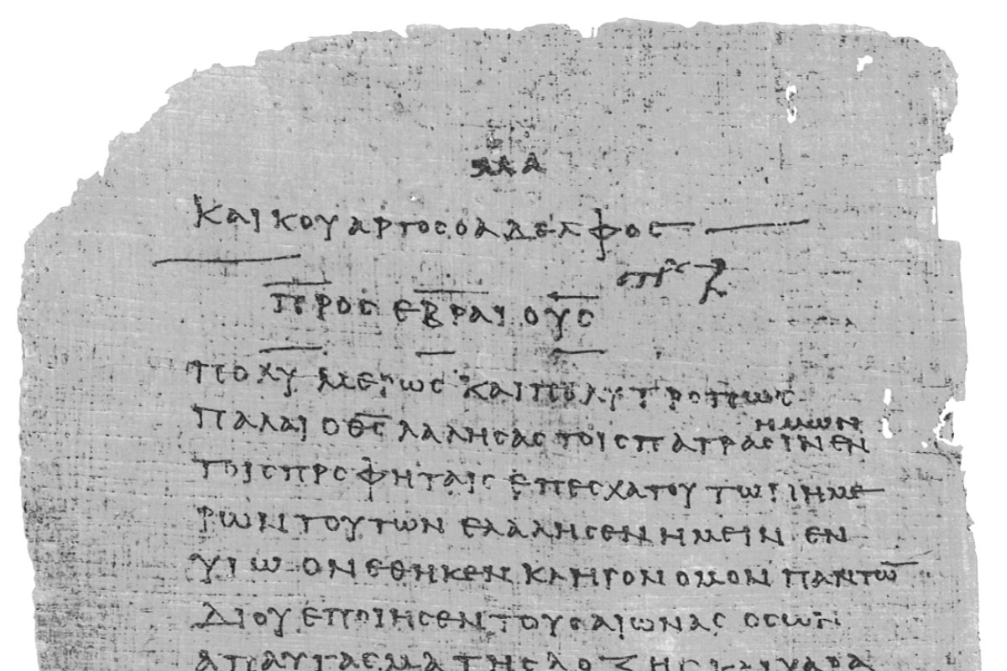
Pharisee Paul’s ἀπολογία to the Hebrews
Ἑβραῖος
Session-15
Hebrews 7:23 thru 8:6
A More Excellent
Ministry
Dr. Dave Newton
© 2025
Figure It Out
Calvary Chapel
Santa Barbara

Slide 2
Pharisee Paul’s ἀπολογία to the Hebrews Ἑβραῖος
Ended Last Week . . .
So much more also Jesus has become the
1. Guarantee our security-deposit [no Levite priest could]
John 14:6 Jesus is the way truth and life
No one goes to Father except thru Him
Ephesians 1:13-14 sealed with God’s Holy Spirit
2. of a Better Covenant prior Covenant-Law has been “annulled”
Jeremiah 31:31-34 Luke 22:20 Matt. 26:28
2nd Corin. 3:6 Heb. 8:6-13
IF Mosaic Law still in place Jesus could NOT be our High Priest
SO that Law is set aside-annulled It cannot perfect anything!
GOD requires righteousness-holiness Mankind cannot do that

Slide 3
Pharisee Paul’s ἀπολογία to the Hebrews Ἑβραῖος
Tonight continue . . .
Hebrews 7:23-25
The former priests, on the one hand, existed in greater numbers [hundreds]
because they were prevented by death from continuing [needed 24 rotations]
but Jesus, on the other hand, because He continues forever
holds His priesthood permanently [unchangeable] therefore He is able also
to save forever those who draw near to God through Him,
since He always lives to make intercession for them
1st Chronicles 24:5 they were divided by courses as officers of the sanctuary of God
24: 7-18 there are 24 courses [Luke 1:15 Zacharias 8th course Abijah]
Number 8:24-26 Priests serve max until age 50 . . . and eventually die
Not a good ‘type’ ‘foreshadow’ for Jesus

Slide 4
Pharisee Paul’s ἀπολογία to the Hebrews Ἑβραῖος
THE LAW JESUS’ POWER
- Aaron - Melchi-Sedek
- Changes - Never changes
- Carnal [in flesh] - Spiritual [eternal life]
- Weak Useless - Perfection draws people to God Almighty
- Restrains People - Enables Mankind
- Cannot Perfect People - Much Better HOPE Perfects Mankind
- External Commandment - Internal Everlasting Life
Heb. 7:25 He is able also to save forever those who draw near to God
uttermost παντελής panteles “perfectly completely”
not about TIME [forever] but about PERFECTION!
thru Him, since He lives forever to make intercession for them
παντελής panteles “perfectly completely”

Slide 5
Pharisee Paul’s ἀπολογία to the Hebrews Ἑβραῖος
Heb. 7:25 He is able also to save Perfectly those who draw near to God
uttermost παντελής panteles “perfectly completely”
NOT about time [forever] but about PERFECTION!
thru Him, since He lives Perfectly to make intercession for them
Jesus is right NOW at the Right Hand of the Father on His Throne
He is our intermediary Great High Priest making intercession for us
We Have Jesus Full-Time! on our behalf
- Hebrews 1:3 Jesus sat down at the right hand of Majesty on High
- Heb. 10:12 after His one sacrifice for all He sat down at right hand of God
- Colossians 3:1 Christ is seated at the right hand of God
- Matt. 24:44 Psalm 110 sit at my right hand until enemies your footstool
- Acts 7:56 I see Son of Man standing at the right hand of God
- Mark 16:19 after Jesus ascended He sat down at the right hand of God

Slide 6
Pharisee Paul’s ἀπολογία to the Hebrews Ἑβραῖος
Hebrews 7:26-28 it was fitting for us to have such a High Priest who is
ἔπρεπεν ἡμῖν ἐγώ τοιοῦτος ἀρχιερεύς
heprepo haymin ego toioutos archiereus
to be becoming as me/us such as this kind chief priest
= for such a High Priest as this became us WOW!
Jesus’ Attributes/Character
- Holy Personal purity, entirely unable to sin!
- Innocent NO evil in thoughts-words-deeds [Pilate Luke 23:4]
- Undefiled NO stain/blemish [our Passover Lamb Exodus 12:5]
- Separated from sinners NO sin in Him at all [2nd Corinth. 5:21]
- Exalted above heavens [Phil. 2:9-11 God has highly exalted Him . . . ]

Slide 7
Pharisee Paul’s ἀπολογία to the Hebrews Ἑβραῖος
Hebrews 7:26-28
Jesus’ Attributes/Character
- Holy Personal purity, entirely unable to sin!
- Innocent NO evil in thoughts-words-deeds [Pilate Luke 23:4]
- Undefiled NO stain/blemish [our Passover Lamb Exodus 12:5]
- Separated from sinners NO sin in Him at all [2nd Corinth. 5:21]
- Exalted above heavens [Phil. 2:9-11 God has highly exalted Him . . . ]
who does not need daily, like those [former Aaronic-Levite] high priests
to offer up sacrifices, first for His own sins and then for the sins of the people
because this He did once for all when He offered up Himself for the Law appoints
men as high priests who are weak, but the word of the Oath which came after
the Law appoints a Son made perfect forever VERY different than Aaron-Levites

Slide 8
Pharisee Paul’s ἀπολογία to the Hebrews Ἑβραῖος
Hebrews 7:26-28 but the word of the Oath which came after the Law
appoints a Son made perfect forever
Hebrew believers in 1st Century AD still revered Moses and the Law
Luke 16:19-31 poor Lazarus and wealthy man in Sheol
27-28 send someone to my family to warn/explain to them
29 They have Moses [Torah] and the prophets
30 if someone goes to them from the dead they will listen
31 if they don’t listen to Moses and prophets, they will not
be persuaded even if someone Is RAISED FROM THE DEAD
John 5:39 you search the Scriptures because you think that in them you have
eternal life, but it is these Scriptures that testify of Me
46-47 IF you believed Moses you would believe Me for he wrote of Me
you don’t believe his writings so why would you believe Me?

Slide 9
Pharisee Paul’s ἀπολογία to the Hebrews Ἑβραῖος
Hebrews 7:26-28 Jesus does not need daily, like Levite priests to offer up sacrifices
first for His own sins and then for the sins of the people
this He did once for all when He offered up Himself
Levitical priests first had to cleanse themselves ceremonially before interceding
[they were sinful men] Wore white robes [Rev. 19:14]
Lev. 8:23 Priests put dab of blood on right ear cleanse what they heard
on right thumb cleanse what they did
on right toe cleanse where they went
Priests were anointed with oil [Lev. 8:9 symbol of the Holy Spirit on them]
Jesus intercedes for us: 1st John 2:1 Romans 5:10
EVERYTHING symbol – type – foreshadow of Jesus!

Slide 10
Pharisee Paul’s ἀπολογία to the Hebrews Ἑβραῖος
Hebrews 7:26-28
the Law appoints men as high priests who are weak, but the word of the Oath
which came after the Law appoints a Son made perfect forever Jesus not weak!
”Sacrifices” BEFORE Passover-Exodus-Sinai-Law NON-Levitical
- Just prior to Sinai Passover Lambs [by had of household, NOT priest]
- Abraham on Moriah offered ram [by regular guy, NOT priest]
- Melchi-Sedek in Salem [priest of Most High God, pre-Aaron, Levites, Law]
- Abel’s blood offering [shed blood NOT by priest]
- God covers Eve and Adam with animal skins [blood shed for covering]
Leviticus Sacrifices Voluntary to God [sweet savor]
Meal offering, Burnt, and Peace
Mandatory for us [not a sweet savor]
SIN offering [specific] TRESPASS [all people]

Slide 11
Pharisee Paul’s ἀπολογία to the Hebrews Ἑβραῖος
Jesus our High Priest serves by SPECIAL designation with OATH
He is ordained by God Almighty
Aaron-Levite priests serve from among lots of men NO oath
Jesus serves as “Son of God”
Aaron-Levite priests are sons of Hebrew men
Jesus according to Melchi-Sedek HIGHER than Aaron-Levites
Aaron-Levite priests according to Mosaic Law
Jesus is pure, holy, entirely without sin
Aaron-Levite priests were all sinful men
Jesus has just ONE sacrifice ONCE for all Puts END to sin
Aaron-Levite priests continuous sacrifices SIN remains
Matthew 3:9 don’t say ”We have Abraham as our father” because
God could raise up children of Abraham from these stones!

Slide 12
Pharisee Paul’s ἀπολογία to the Hebrews Ἑβραῖος
Hebrews 8:1-3 Now the MAIN POINT in what has been said is this Thanks Paul
We have such a High Priest, who has taken His seat
at the right hand of the Throne of the Majesty in the Heavens
a minister in the sanctuary and in the TRUE tabernacle
Jesus is full-time interceding on our behalf
[no seats in earthly tabernacle or Temple, priests always stand]
which the Lord pitched, not man - for every high priest is appointed to offer both gifts
and sacrifices - it is necessary that this High Priest [Jesus] also have something to offer
Jesus has something MUCH better to offer: Salvation!
John 19:30 ”tetelestai” It is finished, Paid-in-full completes redemption
Jesus then steps into His new role as our Great High Priest in Heaven
then harpazo then marriage and Bema, 2nd Coming, Millennium
He NOW sits on His Father’s Throne
later He WILL sit on David’s throne in Jerusalem Luke 1:30-33

Slide 13
Pharisee Paul’s ἀπολογία to the Hebrews Ἑβραῖος
Jesus after Calvary in His new role as our Great High Priest in Heaven
then comes harpazo then marriage and Bema, 2nd Coming, Millennium
Right now He sits on His Father’s Throne in Heaven
In Earth’s future He WILL sit on David’s throne in Jerusalem Luke 1:30-33
2 different thrones!!
Acts 15 [Council of Jerusalem] Jesus’ brother James cites
Amos 9:11-15 God will raise up the fallen throne of David and rebuild it
Psalm 132:11 Lord sworn to David a truth from which He cannot ‘change His mind’
“From the offspring of your body I will set upon your throne”
Isaiah 9:7 Lord will give Him throne of His father David and He will reign over the
house of Jakob [Israel] forever, His kingdom will have no end
2nd Sam. 7:12-16 after you die David, God will raise up a descendent from you
and I will establish the throne of His kingdom forever

Slide 14
Pharisee Paul’s ἀπολογία to the Hebrews Ἑβραῖος
Hebrews 8:4-5 Now if He were on Earth He would not be a priest at all since
THERE ARE those who Offer [present tense] gifts according to the Law
[proves Temple still in Jerusalem Hebrews letter written pre-70]
Missler notes: “Paul makes the case that divinely appointed priests, engaged
in divinely appointed rituals at divinely appointed location”
who serve a copy and shadow of the Heavenly things as Moses was warned
by God when he was about to erect the tabernacle for God says, “See that you
make all things according to the pattern which was shown to you on Mount Sinai”
Exodus 25-27 ark, shewbread, lampstand, curtains, boards + sockets,
veil, bronze altar, courtyard
Exodus 36 construction begins under “skilled” Bezal-El and Oholiab

Slide 15
Pharisee Paul’s ἀπολογία to the Hebrews Ἑβραῖος
copy and shadow of Heavenly things as Moses was warned about the tabernacle
“Make all things according to the pattern which was shown to you on Mount Sinai”
The “true” Temple/Tabernacle:
Rev 11:19 temple of God in Heaven was opened - ark of His covenant appeared in His
temple - flashes of lightning, sounds, peals of thunder, earthquake, and great hailstorm
Rev 15:5 I looked and the temple of the tabernacle of testimony in Heaven was opened
Habakkuk 2:20 the Lord is in His holy temple - let all the Earth be silent before Him
Psalm 11:4 the Lord is in His holy temple - the Lord’s throne is in Heaven
Psalm 102:19 He looked down from His holy height, from Heaven He looked upon Earth
Isaiah 66:1-2 Heaven is My throne and the Earth is my footstool - what is the house
that you would build for Me, and what is the place of My rest?
All these things My hand has made!

Slide 16
Pharisee Paul’s ἀπολογία to the Hebrews Ἑβραῖος
Hebrews 8:6
But NOW He has obtained a more excellent ministry as He is also the
mediator of a Better Covenant which has been enacted on Better Promises
Paul is making the case that NEW Covenant superior to the prior covenant
- The Levitical priesthood of Aaron could not SAVE anyone!
- The wilderness tent-tabernacle and later the Temple in Jerusalem
were simply “models” representative of the true Heavenly Temple
- Jesus brings a BETTER covenant that can save anyone!
- Jesus has a BETTER promise sealed-guaranteed by an Oath
- Aaron and his offspring all died Jesus lives forever to make intercession
- Jesus as our High Priest supersedes Aaron-Levitical priests
What they could only model Jesus FULFILLS!!

Slide 17
Pharisee Paul’s ἀπολογία to the Hebrews Ἑβραῖος
Hebrews 8:6 But NOW He has obtained a more excellent ministry as He is also
Mediator of a Better Covenant which has been enacted on Better Promises
- Paul explains Aaron + Levites mediators within Mosaic Covenant from Sinai
- Jesus is now functioning as Mediator within NEW Covenant from Jeremiah 31
v-31 I will make a NEW Covenant with Israel and house of Judah
v-32 NOT like covenant I made with their fathers as I led them from Egypt
a covenant that THEY broke although I was a husband to them
v-33 but now I will put my Law within them – written on their hearts
I will be their God and they will be my people
v-34 they will not have to teach this because they will ALL KNOW ME!
2nd Corinth. 3 NEW Covenant not of the letter but of THE SPIRIT
Galatians 3 NEW Covenant does not invalidate the original Promise

Slide 18
Pharisee Paul’s ἀπολογία to the Ἑβραῖος
NEXT WEEK
Session-16
Hebrews 8:7 thru 9:18
Details of NEW Covenant

Slide 20
