Slide 1
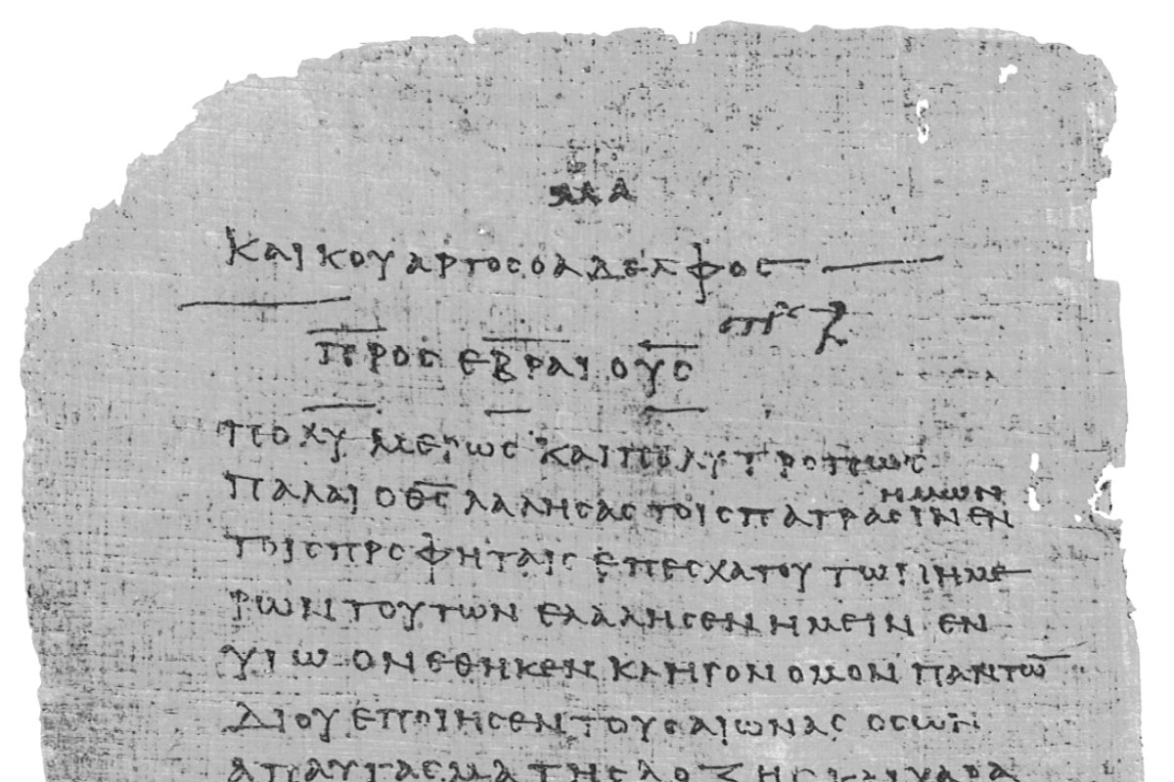
Pharisee Paul’s ἀπολογία to the Hebrews
Ἑβραῖος
Session-17
Hebrews 9:19 thru 10:4
Comparing
Cleansing Sacrifices
Dr. Dave Newton
© 2025
Figure It Out
Calvary Chapel
Santa Barbara

Slide 2
Pharisee Paul’s ἀπολογία to the Hebrews Ἑβραῖος
Last week finished up with verse-18
Jesus is Mediator of NEW Covenant
HIS death took place for Redemption of Transgressions
In first Covenant, believers receives Promise of eternal inheritance
based on Testament - BUT there must be death of the ONE who made
Testament because it is only valid when that man has died
Never in force while the ONE who made Testament still lives
As such, first Covenant was NOT inaugurated without blood

Slide 3
Paul’s Bibliography reminder: Romans 15:4 Hebrew Scriptures for OUR benefit!!
2 Samuel 7:12-14 Heb 1:5a
Psalm 2:7 Heb 1:5b
Psalm 104:4 Heb 1:7
Psalm 45:6-7 Heb 1:8-9
Psalm 102:25-27 Heb 1:10-12
Isaiah 34:4-12 Heb 1:12
Psalm 110:1 Heb 1:13
Psalm 8:4-6 Heb 2:5-10
Psalm 22:22 Heb 2:12
Isaiah 8:17 Heb 2:13
Isaiah 8:18 Heb 2:13
Psalm 95:8-11 Heb 3:7-11
Psalm 95:11 Heb. 4:3
Genesis 2:2 Heb 4:4
Psalm 2:7 Heb 5:6
Psalm 110:4 Heb 5:6
Deut. 32:43 Heb 6:1
Gen 22:16-17 Heb 6:14
Psalm 110:4 Heb 7:17
Psalm 110:4 Heb 7:21
Exodus 25:40 Heb 8:5
Jeremiah 31:31-34 Heb 8:7-13 10:15-18
Exodus 24:8 Heb 9:20
Psalm 40:6-8 Heb 10:5-10
Deut. 32:35 Heb 10:30
Deut. 32:36 Heb 10:30
Habakkuk 2:3-4 Heb 10:37-38
Gen 21:12 Heb 11:18
Prov. 3:11-12 Heb 12:5-6
Deut. 9:19 Heb 12:21
Haggai 2:6 Heb 12:26
Deut. 31:6 Heb 13:5
Psalm 118:6 Heb 13:6

Slide 4
Hebrews 9:19-22. For when EVERY commandment had been spoken by Moses to all the
people according to the Law, he took the blood of the calves and the goats, with water,
scarlet wool, and hyssop, and sprinkled both the Book itself and all the people, saying,
βιβλίον biblion [of Covenant]
“This is the blood of the covenant which God commanded you”
Exodus 24:3-8 Moses recounted to the people all the words of the Lord and all the
ordinances - all the people answered with one voice, “All the words the Lord has
spoken We Will Do” then Moses wrote down all the words of the Lord
John 5:46-47 Jesus states Moses wrote the Torah
Then he arose early in the morning, built an altar at the foot of Sinai with 12 pillars for
the 12 tribes of Israel - they offered burnt offerings and sacrificed young bulls as peace
offerings to the Lord - Moses took the blood and sprinkled it on the altar, he took the
biblion of the Covenant and read it in the hearing of the people and they said,
”All the Lord has spoken we will do - we will be obedient!” Moses sprinkled blood on
The people, and said, “Behold the Blood of the Covenant, which the Lord has made
with you in accordance with all these words”

Slide 5
Pharisee Paul’s ἀπολογία to the Hebrews Ἑβραῖος
Reminders . . .
Luke 22:20 this cup which is poured out for you is the New Covenant in my blood
1st Corinth. 11:25 this cup is the New Covenant in my blood
And in the same way he sprinkled both the tabernacle and all the vessels of the ministry
with the blood - and according to the Law, one may almost say, all things are cleansed
with blood, and without shedding of blood there is no forgiveness of sin
TODAY in 2025 there is no place to do this!
Rev. 7:14 robes made white because of blood of the Lamb
Rev. 12:11 they overcame because of blood of the Lamb
Genesis 3 YHWH shows Adam and Eve how blood “covers” kippur
BUT kippur-cover does not TAKE AWAY sin

Slide 6
Pharisee Paul’s ἀπολογία to the Hebrews Ἑβραῖος
Hebrews 9:23-26. Therefore it was necessary for the Pattern of the things in Heaven
to be cleansed with these, but the Heavenly things themselves with better
sacrifices than these ὑπόδειγμα hupo-deigma = Patterned copy of original
hypodeigma [hypo means under]
for Christ did not enter a Holy Place made with hands
a mere COPY of the true one ἀντίτυπος anti-tupos = pseudo-resemblance
anti-typos “antichristos” in Revelation
but into Heaven itself pseudo-type
WAIT a MINUTE! okay, Earthly tabernacle cleansed-purified symbolically with animal
blood, but WHY would Heavenly Temple need to be cleansed with better sacrifice?
- Isaiah 14 original sin-disobedience happened there [not Adam-Eve on Earth]
- Ezekiel 28 original sin of Lux-Fer shining-brazen one

Slide 7
Pharisee Paul’s ἀπολογία to the Hebrews Ἑβραῖος
Hebrews 9:23-26.
mere COPY of the true Temple, but Jesus went into the one in Heaven itself [not copy]
now to appear in the presence of God for us
nor was it that He [Jesus] would offer Himself often as the [Levite] high priest enters
the Holy Place year by year with blood that is not his own [animal blood]
otherwise, He would have needed to suffer OFTEN since the foundation of the world
original sin pre-Earth, pre-Adam
κόσμος kosmos = entire universe overhead
but now once at consummation [Fullness, time near wrapping things up] of the ages
αἰών aion = extended period of literal time
He has Appeared [been manifested] to put away sin by the sacrifice of Himself
Permanently Jesus is the Lamb of God…
ἀθέτησις athetaysis = abolish [like the Law]

Slide 8
Pharisee Paul’s ἀπολογία to the Hebrews Ἑβραῖος
COVENANT COMPARISON OLD NEW
- for Hebrews - for Gentile sinners too
- animal blood - Jesus Mashiach blood
- continuous sacrifices - ONCE for ALL
- kippur sin - permanently removes sin
- Holy of Holies on Earth - Temple in Heaven
- Priest comes out to - Jesus comes to GET
bless the people His people ‘harpazo’

Slide 9
Pharisee Paul’s ἀπολογία to the Hebrews Ἑβραῖος
Hebrews 9:27-28. and inasmuch as it is appointed for men to die once and
after this comes judgment, so Christ also, having been offered once
to bear the sins of many, will appear a Second Time for Salvation
without reference to sin, to those who eagerly await Him
Biblical Exceptions?
Genesis 5:24 Enoch was taken up [harpazo]
2nd Kings 2:11-12 Elijah was taken up [harpazo]
John 11:38-44 Lazarus resurrected from dead
Jonah 2:1-6 Jonah drowned, went to Sheol, was resurrected
Mark 5 Luke 8 Jairus’ daughter was resurrected
Luke 7:11-16 in village of Nain woman’s dead son resurrected
Matt. 27:52-53 many people resurrected from Sheol “Abraham’s promise”
when Jesus resurrected from the tomb

Slide 10
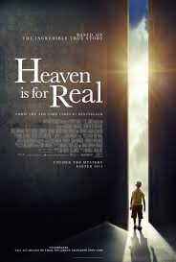
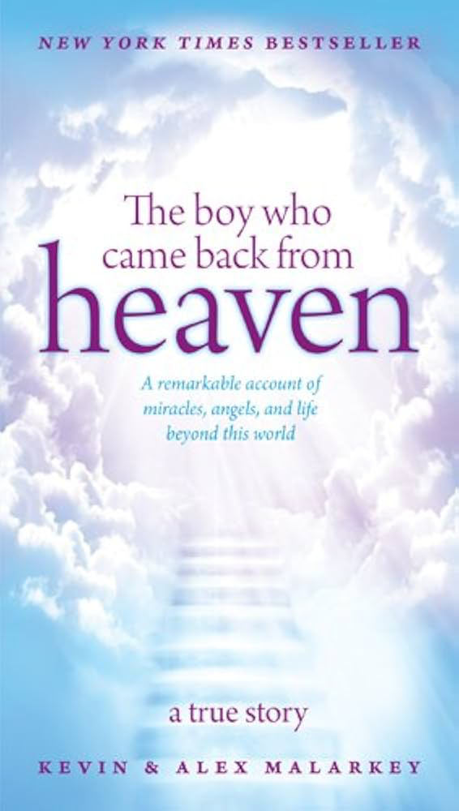
“appointed to die once, after this comes judgment” [Sheol then Great White Throne]
Powerful statement/principle/doctine that refutes both:
- supposedly Near-Death Experiences [NDE], and
- false doctrine of Reincarnation
NDEs include unbelievers, but also supposedly ‘Christians’
- Paul ‘caught up’ to the 3rd Heaven was not near-death experience
- John ‘caught up’ into Heaven for the Revelation from Jesus was not NDE
Recanted as ‘made-up’

Slide 11
Pharisee Paul’s ἀπολογία to the Hebrews Ἑβραῖος
“it is appointed to die once and after this comes judgment”
- supposed Near-Death Experiences [NDE], and
BIG Concern with these: WHY would God reveal ‘NEW’ things to people that are
not contained in the existing complete-testimony Scriptures?
2nd Peter 1:19-21 no prophecy is a matter of one’s own interpretation
NO prophecy was ever made by act of human will
KEY: Let the Bible explain NDE
Don’t let NDEs explain the Bible 2nd Tim. 3:16-17 Scripture is sufficient for all

Slide 12
Pharisee Paul’s ἀπολογία to the Hebrews Ἑβραῖος
“it is appointed to die once and after this comes judgment”
- supposed Reincarnation [Hinduism]
started with the Kabbalah 12th/13th Century AD into Judaism
- NO Karma [actions in one life determine fate in next life]
NO cycles of rebirth within nature as per Hindu: Upanishads, Bhagavad Gita, Vedas
2nd Corinth. 2:5-7 absent from this physical body then present with the Lord
Gen. 3:19 physical death is for all mankind
Romans 5:12-14 sin entered the world and death with sin
KEY: Animals do not die and come back as people [moving up]
People do not die and come back as animals [moving down] Cows in India
- Animals are NOT created with a spirit
- Only mankind is created in “OUR Image” of God with an eternal spirit
physical body soma consciousness psuche spirit pneuma
Gen. 2:7 God breathed into Adam’s nostrils, became “living being”

Slide 13
Pharisee Paul’s ἀπολογία to the Hebrews Ἑβραῖος
Hebrews 9:27-28. Christ having been offered once to bear the sins of many
will appear a Second Time for Salvation [“I will be saved”]
without reference to sin, to those who eagerly await Him [harpazo 2nd Coming]
Matthew 24:26-31 coming of the Son of Man like lightning East to West
Matthew 24:36-44 coming of the Son of Man like the days of Noah
Revelation 1:7 He is coming in the clouds and every eye will see Him
1st Thess. 4:16-17 Lord will descend with shout and harpazo
1st Thess. 5:1-3 Day of the Lord like a thief in the night
1st Corin. 15:50-58 we will not all die but some ‘translated’ in an eye-blink
Luke 21:27 they will see Son of Man coming in cloud with power
and glory

Slide 14
Pharisee Paul’s ἀπολογία to the Hebrews Ἑβραῖος
Paul’s continuity from end of Chapter-9 now explaining 9:19-28 [we just covered]
as he connects them with “For” [segue to the rational, logical, reason]
who eagerly await Him 10:1-4 For the LAW, since it has only a shadow of the
good things to come and not the very [actual] form of things σκιά skia
sketch in a dim light
The IDEA is that Earthly models are minimally close to -
in size, scale, beauty - the actual-true-real in Heaven
shadow Always accompanied by “only” to further accentuate limits of models
sometimes with “mere” Colossians 2:17
Other Greek: 2] ἀποσκίασμα aposkiasma = exact representation
James 1:17 Father of lights with whom no shifting aposki-asma
3] εἰκών eikon = image likeness statue portrait EXACT same as original
English “icon” = connotation

Slide 15
Pharisee Paul’s ἀπολογία to the Hebrews Ἑβραῖος
The LAW, the TEMPLE, the ARK, the MENORA . . . could not be perfectly ‘shadowed’
The SACRIFICES . . . also “mere” shadows Animal blood? vs. Jesus blood
can NEVER by the same sacrifices which they offer continually year by year, make
perfect those who draw near . . . otherwise would they not have ceased to be offered?
Makes perfect sense! All foreshadows HAD to cease
Also: they offer continually is present tense for Paul writing mid-60s AD
which means Temple sacrifices with Levite priests were going on THEN
this dates Paul’s Apologia-Epistle to Hebrew Christians pre-70AD
Because the worshipers having once been cleansed, would no longer have had
consciousness of sins - BUT in those [animal] sacrifices there is a reminder of sins
”remembrance”
year by year for it is impossible for the blood of bulls and goats to take away sins
kippur ‘cover’ is impossible to take away our sins!!

Slide 16
Pharisee Paul’s ἀπολογία to the Hebrews Ἑβραῖος
it is impossible for the blood of bulls and goats to take away sins
kippur ‘cover’ is impossible to take away our sins!!
In Torah ‘cover’ is כָּפַר kafar Gen. 6:14 Noah used pitch/tar to cover the ark
it patched the gopher wood
The heifer-bull-goat-lamb-ram DID NOT willingly give their lives for mankind
Psalm 40:6-7-8 Sacrifice and meal offering You have NOT desired
my ears You have opened, burnt offering and sin offering You have NOT required
Then I said, “behold, I come in the scroll of the book it is written of Me
I delight to do Your will, Oh my God, Your Law is within my heart
1st Samuel 15:22 to obey is better than sacrifice, to heed the word of the Lord is better
than fatling of rams [regarding Saul’s attempted loop-hole]
THERE IS NOW ONLY ONE SACRIFICE!!

Slide 17
Pharisee Paul’s ἀπολογία to the Ἑβραῖος
NO STUDY
NEXT WEEK Memorial Day Holiday Long Weekend
Session-18
June 2nd
Hebrews 10:5-25

